Slide 1

Covid-19 Indian
JIN NINGXIAN

Slide 2

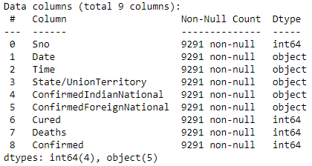
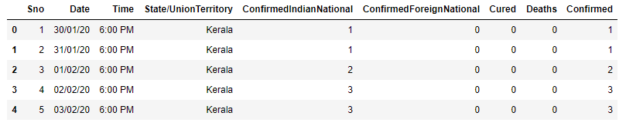
Data information (before data cleaning)
Dataset Source: https://www.kaggle.com/sudalairajkumar/covid19-in-india?select=StatewiseTestingDetails.csv

Slide 3
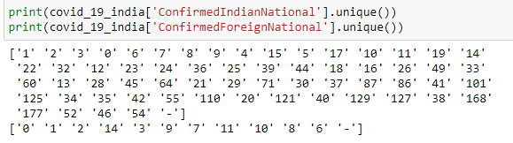
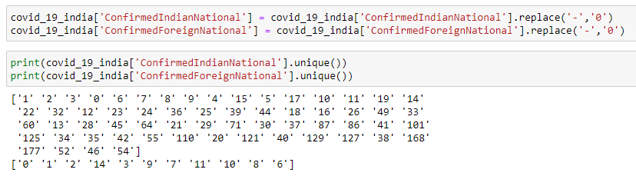
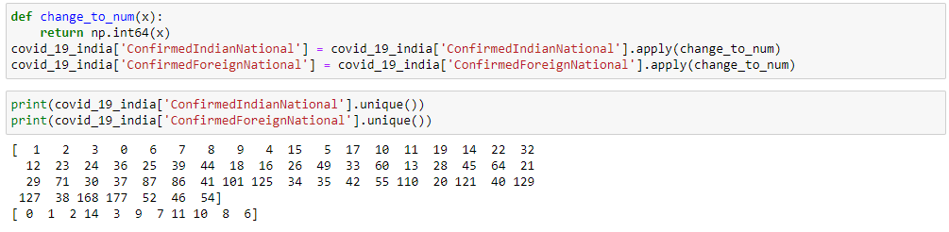
Data Cleaning

Slide 4
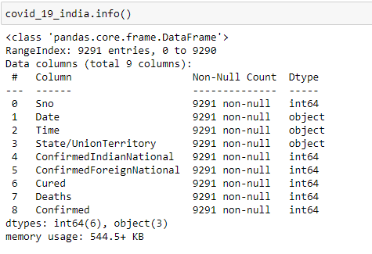
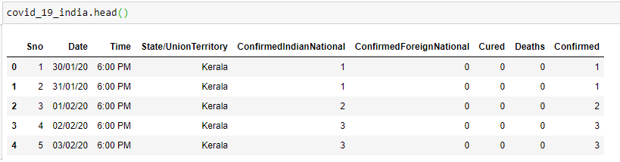
Data Information (after data cleaning)

Slide 5
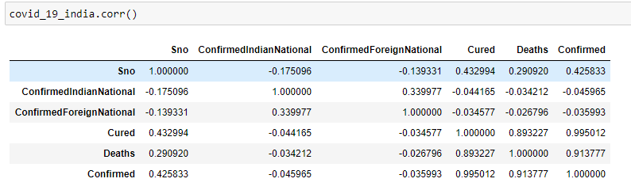
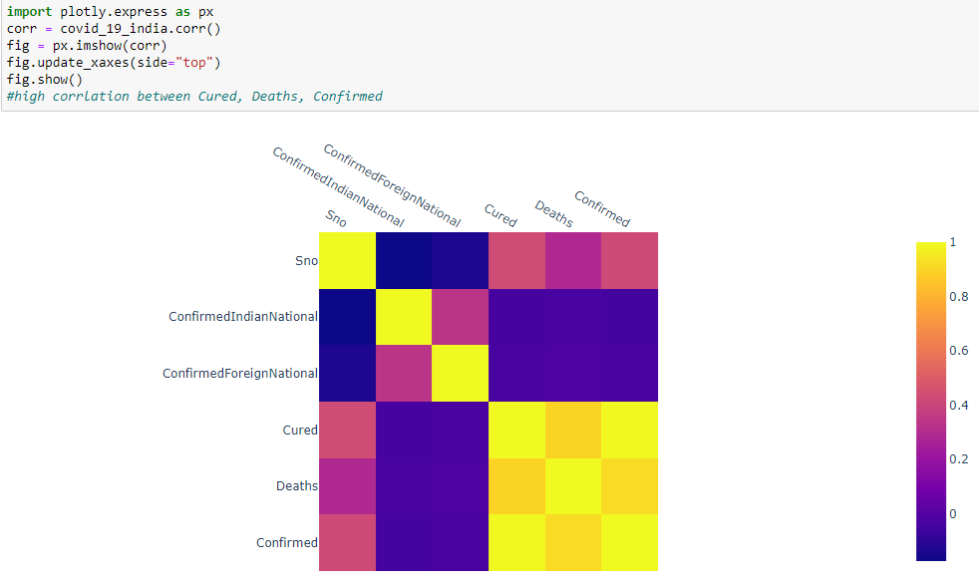
Dataset Correlation

Slide 6

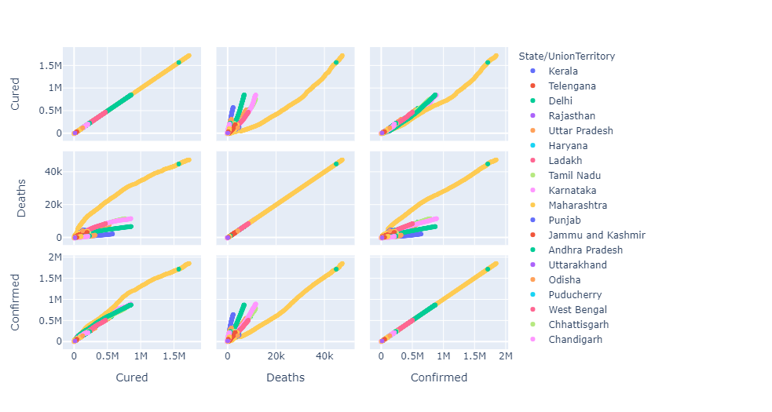
Scatter matrix for correlation

Slide 7
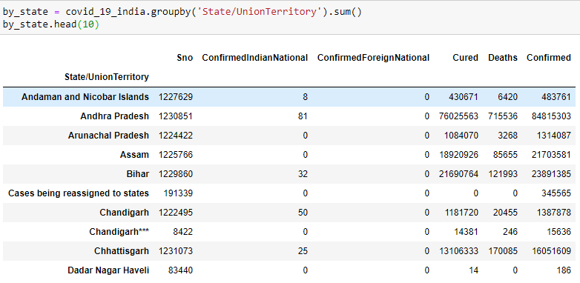
Group dataset by State/UnionTerritory

Slide 8
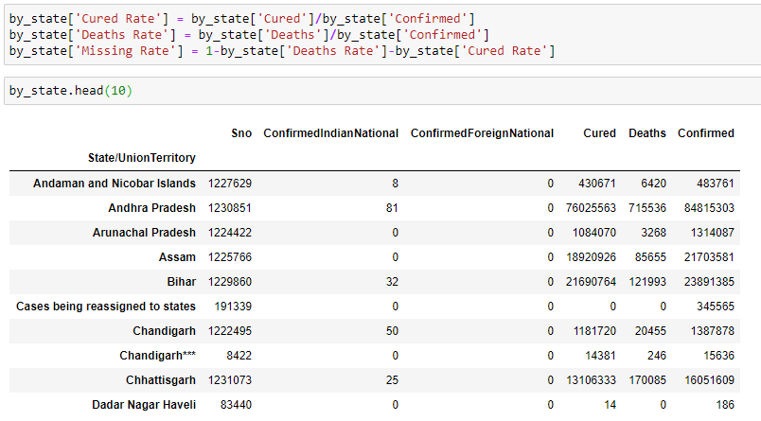
Form new useful columns

Slide 9
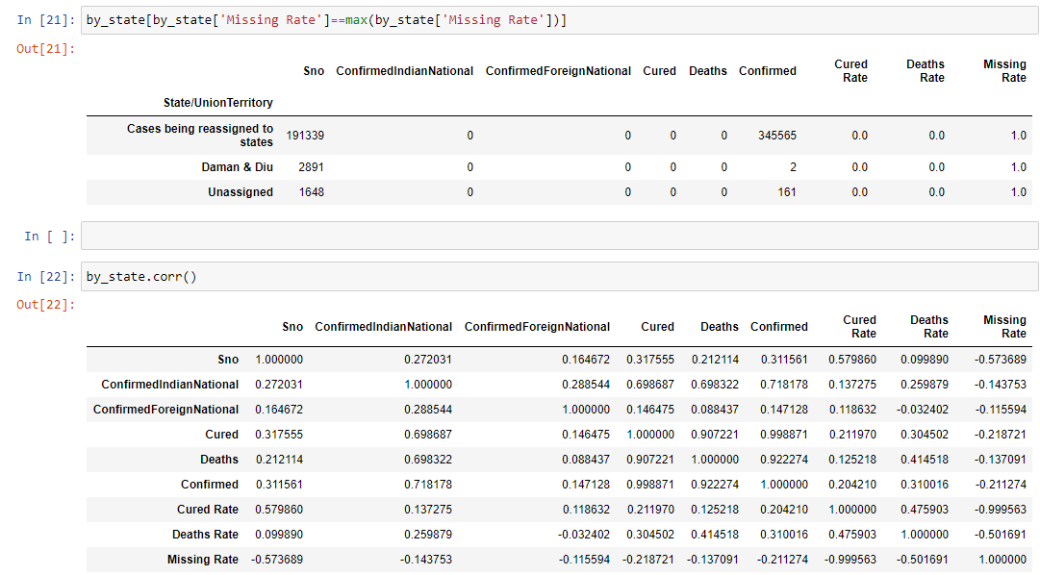
Key information

Slide 10
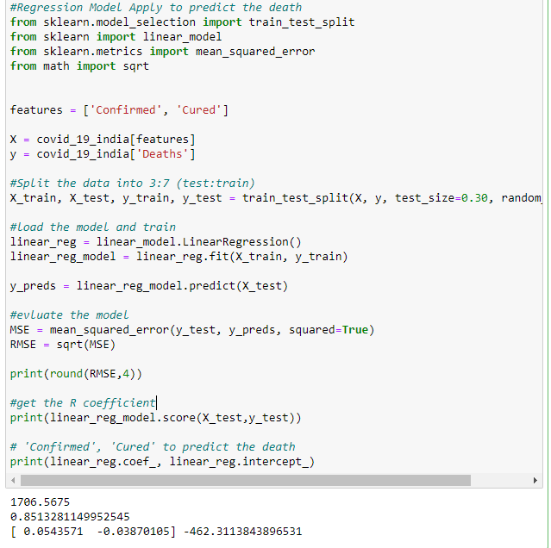
Model Training – Multiple Regression
Number of Death = Number of Confirmed * 0.0543571 – Number of Cured * 0.03870105 – 462.311

Slide 11
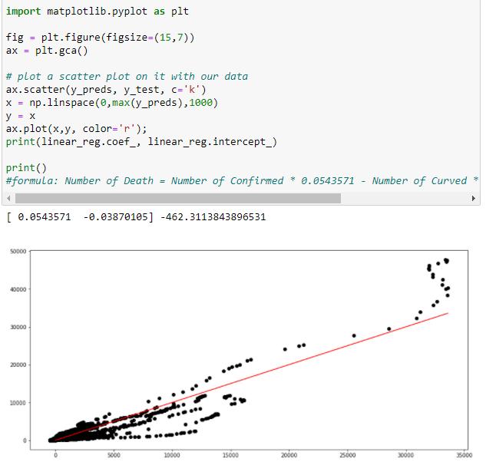
Prediction linear graph

Slide 12
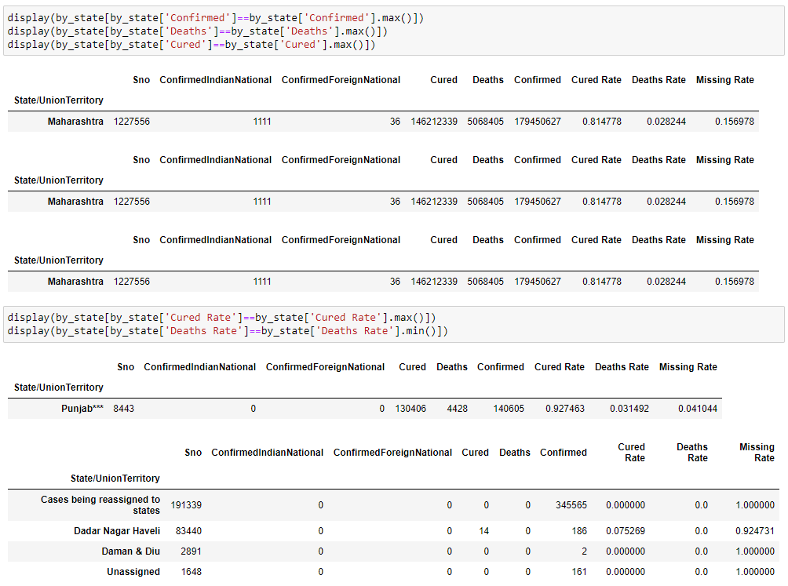
Generate new dataset I

Slide 13
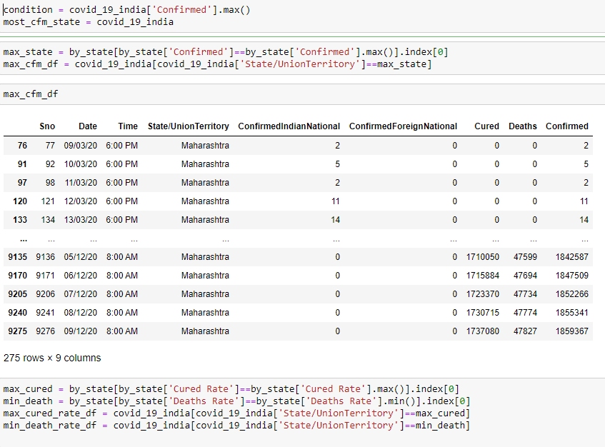
Generate new dataset II

Slide 14
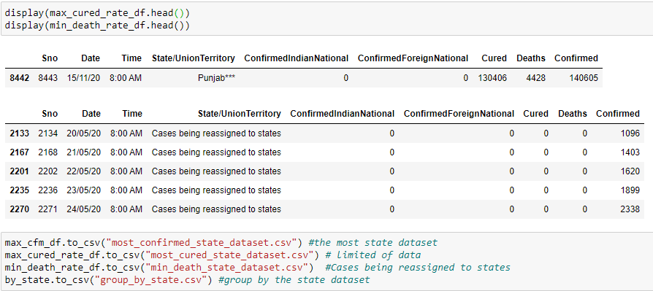
Generate new dataset III

Slide 15
Further Analysis on Tableau
reference Link: https://public.tableau.com/profile/jin.ningxian3668#!/vizhome/IndianCovid/Story1?publish=yes

